Slide 1
Hypothesis
Goal
Tasks
The network will work faster, more optimally, and will be more maintainable when replacing unmanaged switches with managed ones.
Dismantling of existing switches, replacement with managed ones. Network performance improvement.
Analyze the needs of the network, select the necessary equipment
Purchase, receive switches
Dismantle old unmanaged, install new managed switches
Configure the installed equipment for optimal network operation
Evaluation of network performance improvement after upgrade

Slide 2
Network switches
A computer network in an enterprise can connect hundreds, and sometimes thousands of devices. Special devices switches are used to connect them. One of the main characteristics of switches is their manageability. There are managed and unmanaged switches.
Key Differences Between Managed vs Unmanaged Switches
As the name suggests, one of the key differences between a managed and unmanaged switch lies in its approach. A managed network switch provides flexibility to the network administrator to control, manage, and prioritize the LAN traffic. However, an unmanaged switch works like a plug and play switch which allows devices on the LAN to communicate with each other, without user intervention. The following points will help you understand other key points between these two network switches:
Freedom of Configuration:
The managed switches allow users to manage, configure, as well as monitor the LAN. They allow users to create new LANs and segregate smaller devices and help users manage the traffic effectively. Managed network switches come with advanced features that allow users to recover data in the event of failure of the device or network. They also allow data recovery. Unmanaged switches may be easy to use, but they come with a fixed configuration, which means you cannot make changes to the networks. This is why it is most commonly used for startup businesses having limited data exchange.

Slide 3
Performance Management:
Unmanaged network switches are the plug and play type switches. They have built-in QoS services, which ensure their easy setup and utility. However, the managed network switches allow you to manage the performance by prioritizing the channels. It utilizes protocols such as Simple Network Management Protocol (SNMP) to monitor the ethernet network the performance of all devices connected on the LAN. The managed switch also uses SNMP to analyze the current performance of devices on the network through an easy-to-understand graphical interface. Additionally, SNMP also enables remote management of the connected devices and network, without requiring a physical intervention on the switch.
Security Features:
Unmanaged switches have basic security features such as a lockable port cover that ensures basic security, and helps avoid any type of direct tampering on the device. However, managed network switches are equipped with advanced features that help identify active threats and shut them down on time, and protect data and control.
Costs:
The unmanaged network switches are available in affordable price ranges, whereas the managed switches are available in higher price ranges owing to their advanced features.

Slide 4
Hard to decide
It is not always possible to predict whether the network will expand. In our situation, the increase in computers on the network was not originally intended, but later it happened exactly like this. There is no scalability that would be provided by managed switches, therefore it is necessary to completely remove the old equipment, replacing it with a new one. The project is quite large-scale, but the result justifies the necessary costs. Depending on the existing characteristics of the network and its requirements, it is necessary to make a choice of the purchased equipment.

Slide 5
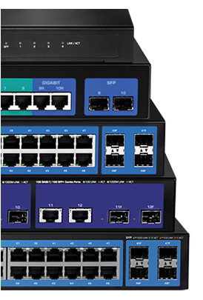
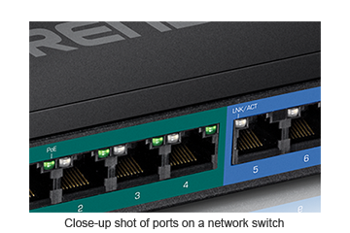
Characteristics of managed switches
Speed Required bandwidth will determine whether you need a 10G, 2.5G, Gigabit, or 10/100 switch. Fast Ethernet or 10/100 switches are more cost-effective, but Multi-Gigabit and Gigabit switches can provide better scalability. Choose a speed that is enough for your current project, but plan for the future and consider extra bandwidth.
Port count
Determine how many devices that need to be connected in order to identify the number of ports you’ll need. For your surveillance solutions, we recommend reserving 2 additional ports for your NVR and/or network bridge/client.
Form factor
The form factor that you choose will come down to both your own personal preference and the switch’s application. Desktop and wall-mountable switches are great when you want to save space; they are generally more affordable and are quieter since most desktop and wall-mount switches do not have internal fans. Rackmount switches are ideal when you want to integrate it into a new or existing server room or rack. DIN-rail switches are usually reserved for industrial applications.
Features
Managed switches include a variety of features for traffic management, troubleshooting, access controls, and monitoring. Some common features include LACP, VLAN, QoS, IGMP snooping, and bandwidth control per port.

Slide 6
Installation of equipment
After purchasing and receiving the necessary equipment. The old equipment is being dismantled and new equipment is being installed. It is necessary to do this without stopping the work of the enterprise. Installation and configuration work is carried out by qualified specialists. After the installation and equipment setup work is completed, time is needed to test the network operation, correct possible errors until all network nodes are fully restored.Summing up, it is necessary to evaluate the work of the new enterprise network taking into account all new opportunities.

